Slide 1

ACROPOLIS INSTITUTE OF TECHNOLOGY AND RESEARCH
Internship Project EC
Session:2023-2024
Hydroponic System Using ESP8266
Submitted To:-
Prof. Minakshi Halder
Submitted by:-
Gourav Soni 0827EC213D01

Slide 2
Outline:-
What is Hydroponic ?
What are the Materials Used ?
Types of Hydroponic System.
What are the Benefits of Hydroponic farming ?
What are the Drawbacks of Hydroponic farming?
Hydroponic Setup
Conclusion

Slide 3
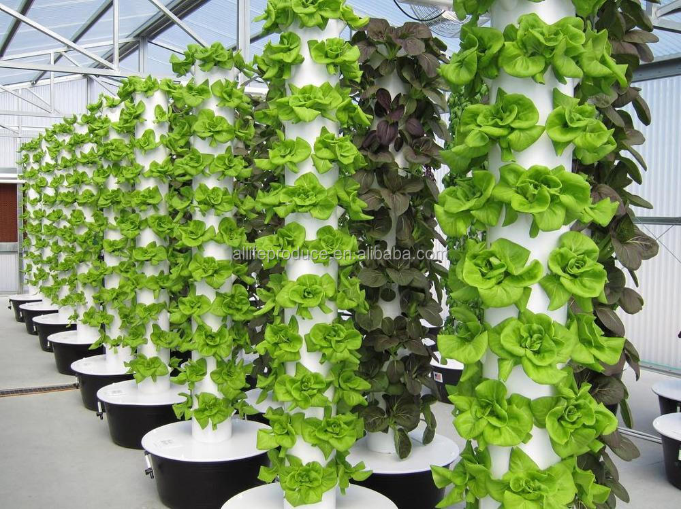
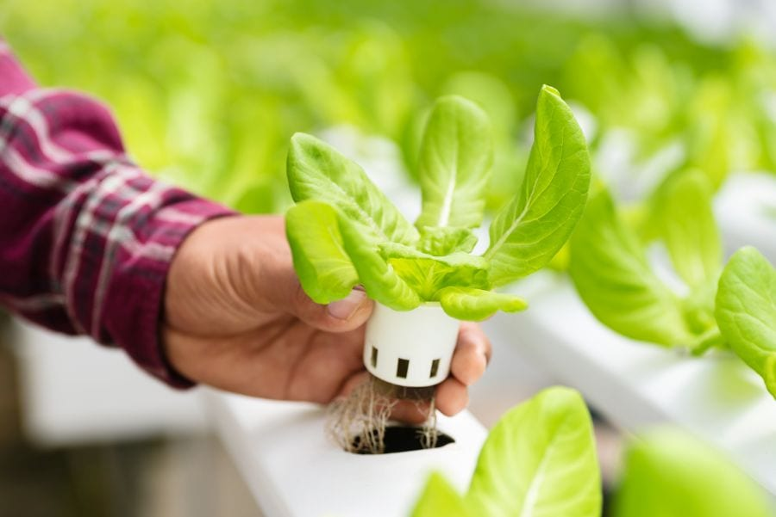
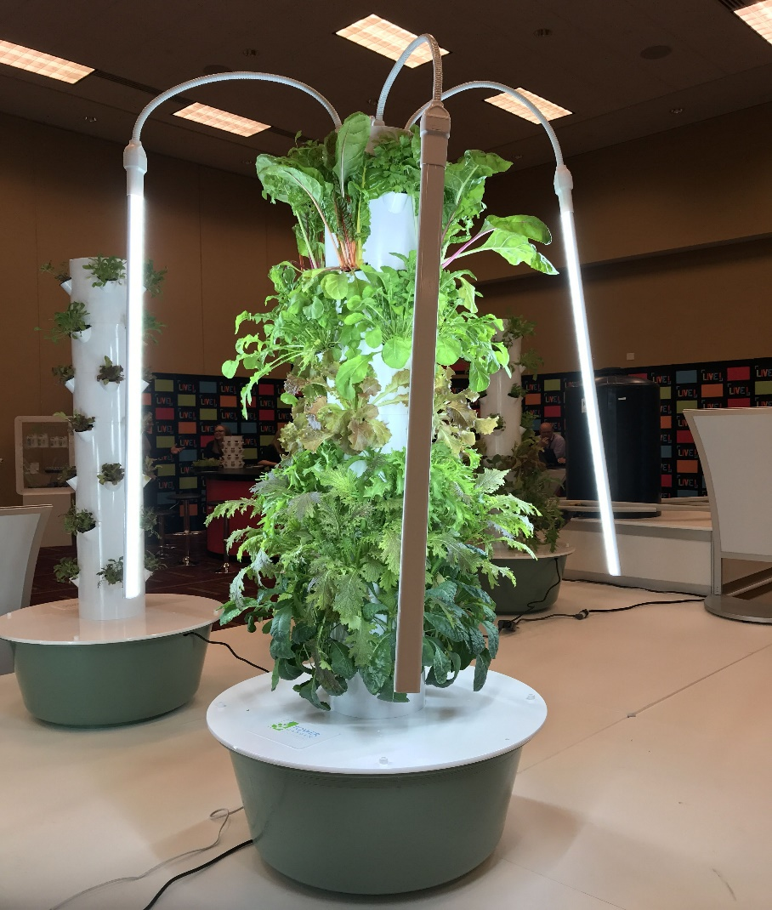
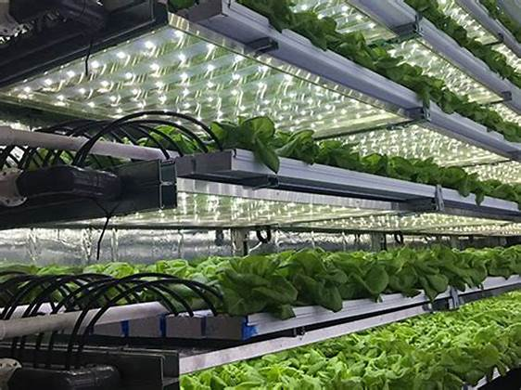
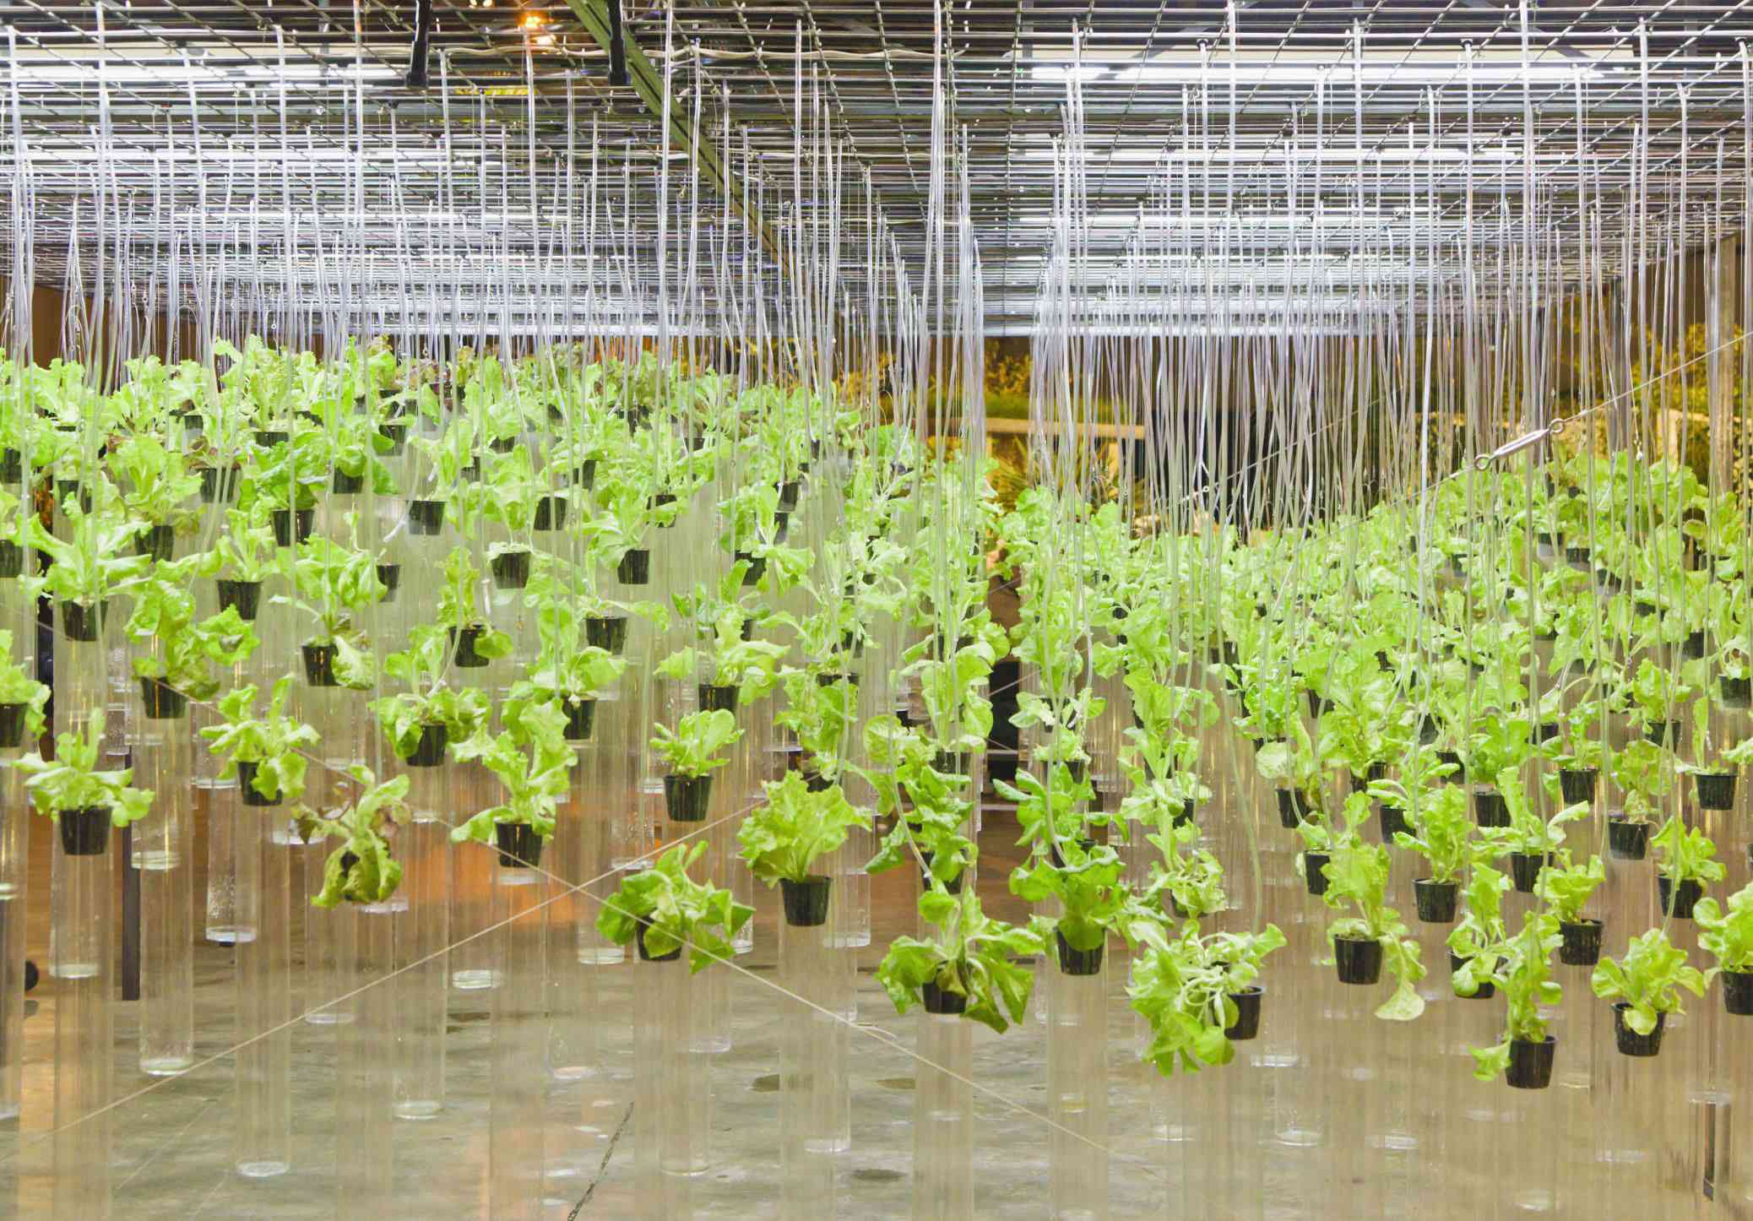
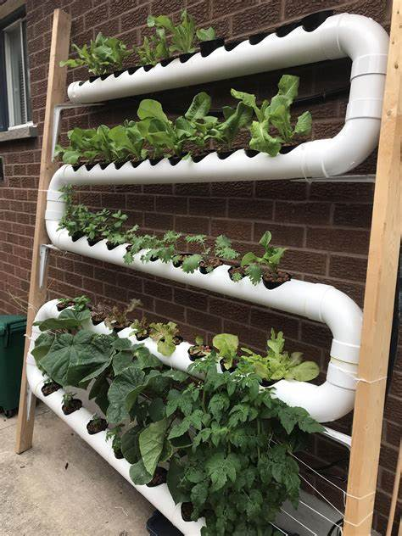
Hydroponic System

Slide 4
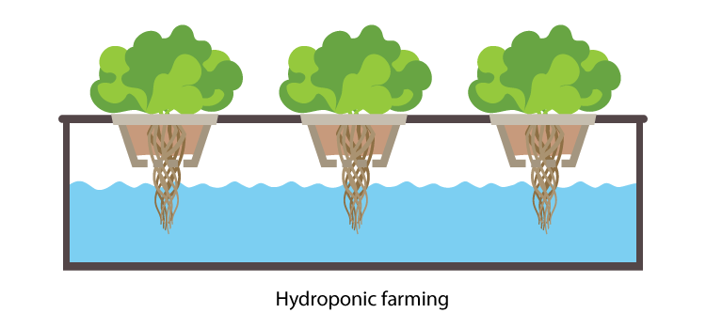
What is Hydroponic ? The word “Hydroponics” is derived from the word “hydros” meaning water and “ponos” meaning toil or labour. It is an agricultural technique where plants are grown in a nutrient solution in the complete absence of soil.

Slide 5
What are the Materials Used ?
Node MCU ESP8266
Solenoid valve
Temperature and Humidity sensor (DHT22)
Arduino UNO
Soil sensor
Relay

Slide 6
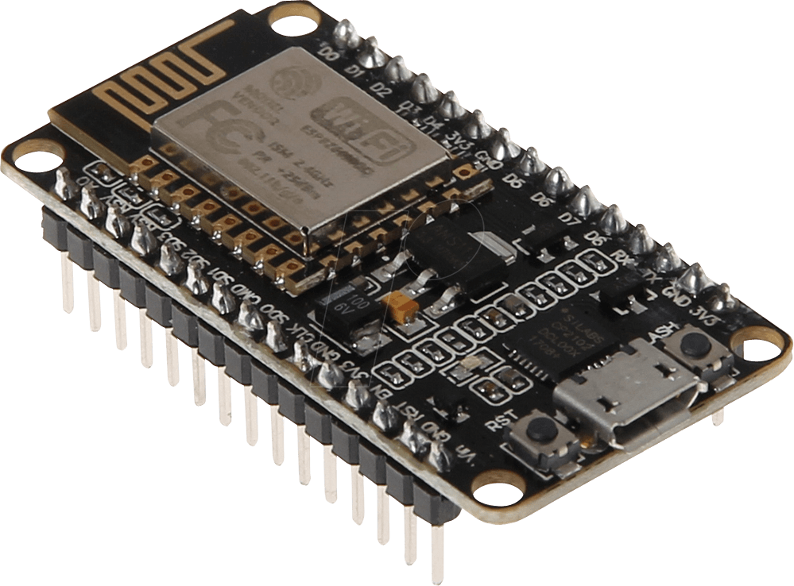
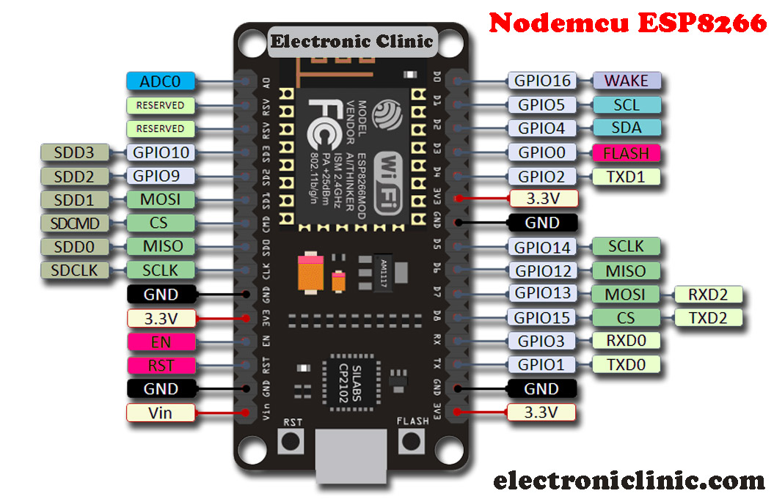
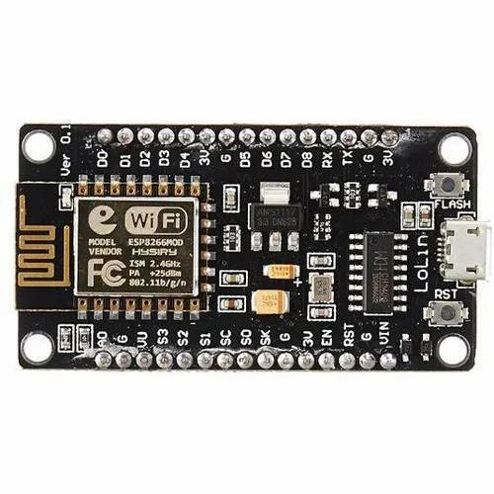

Slide 7
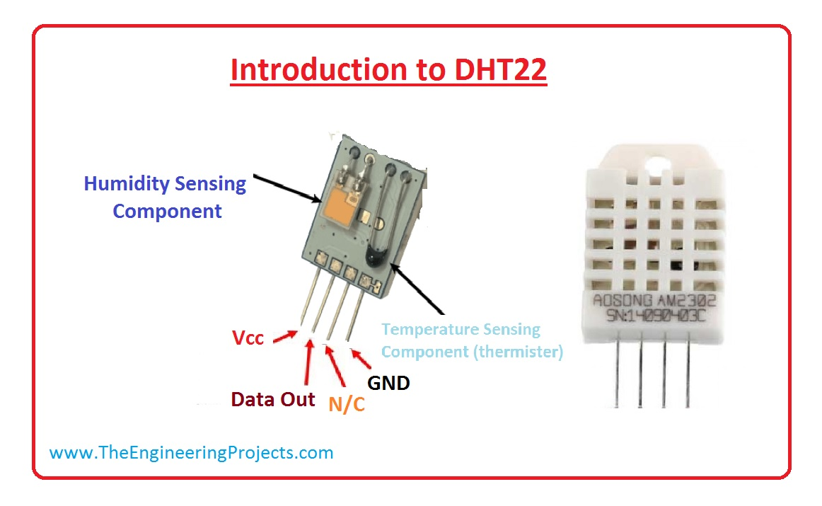
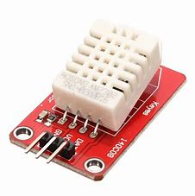
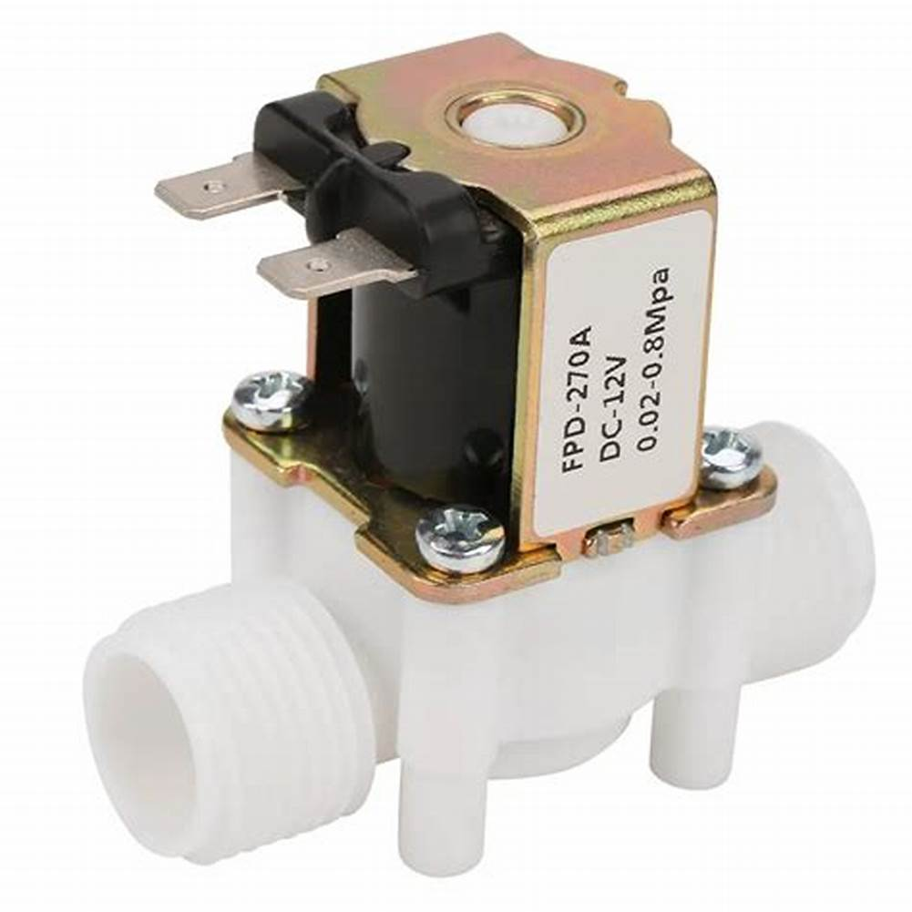
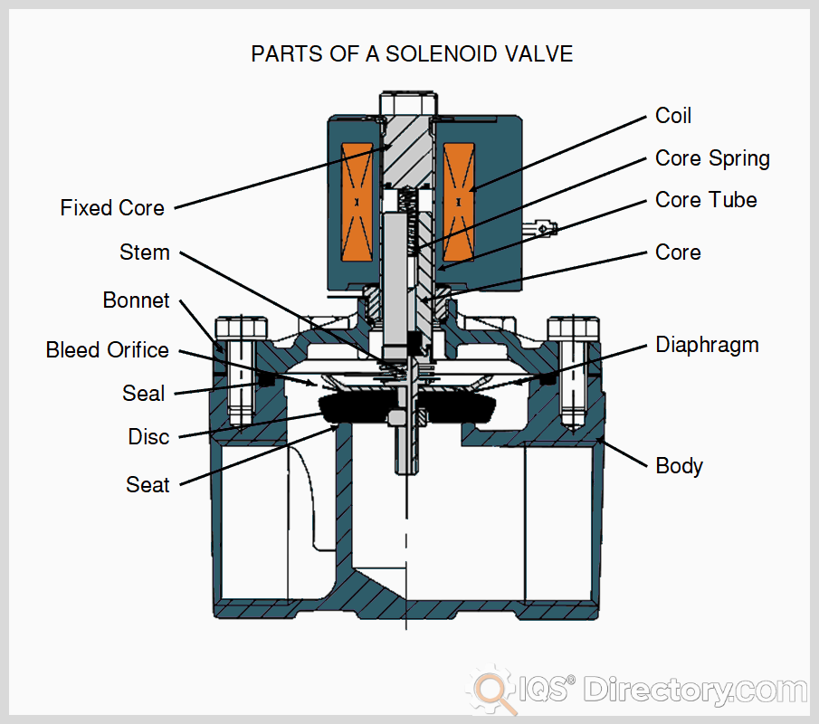

Slide 8
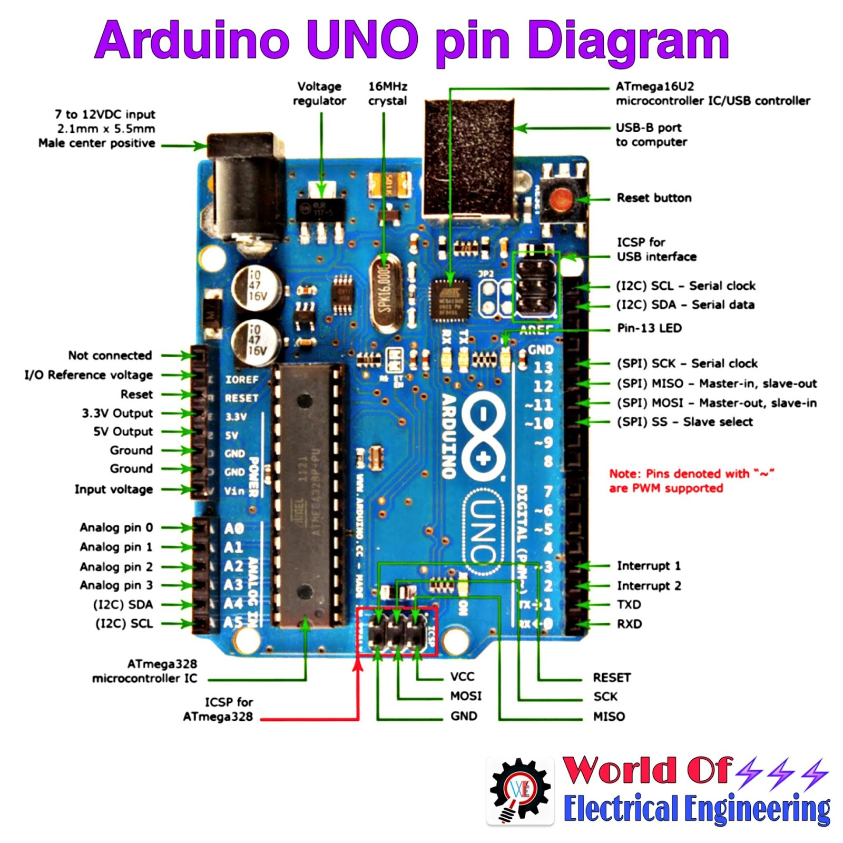
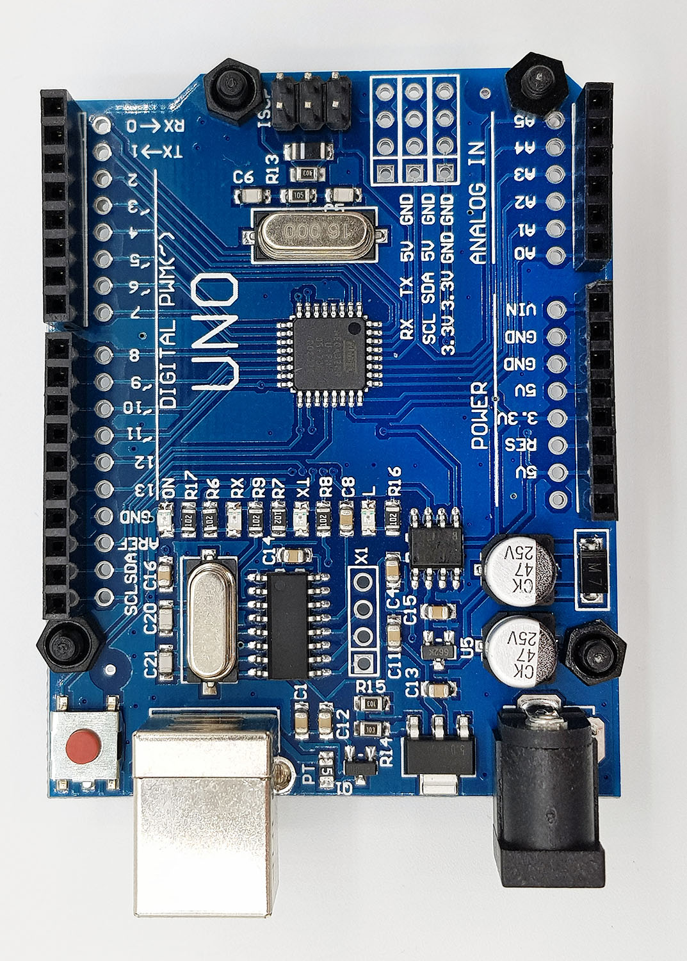

Slide 9
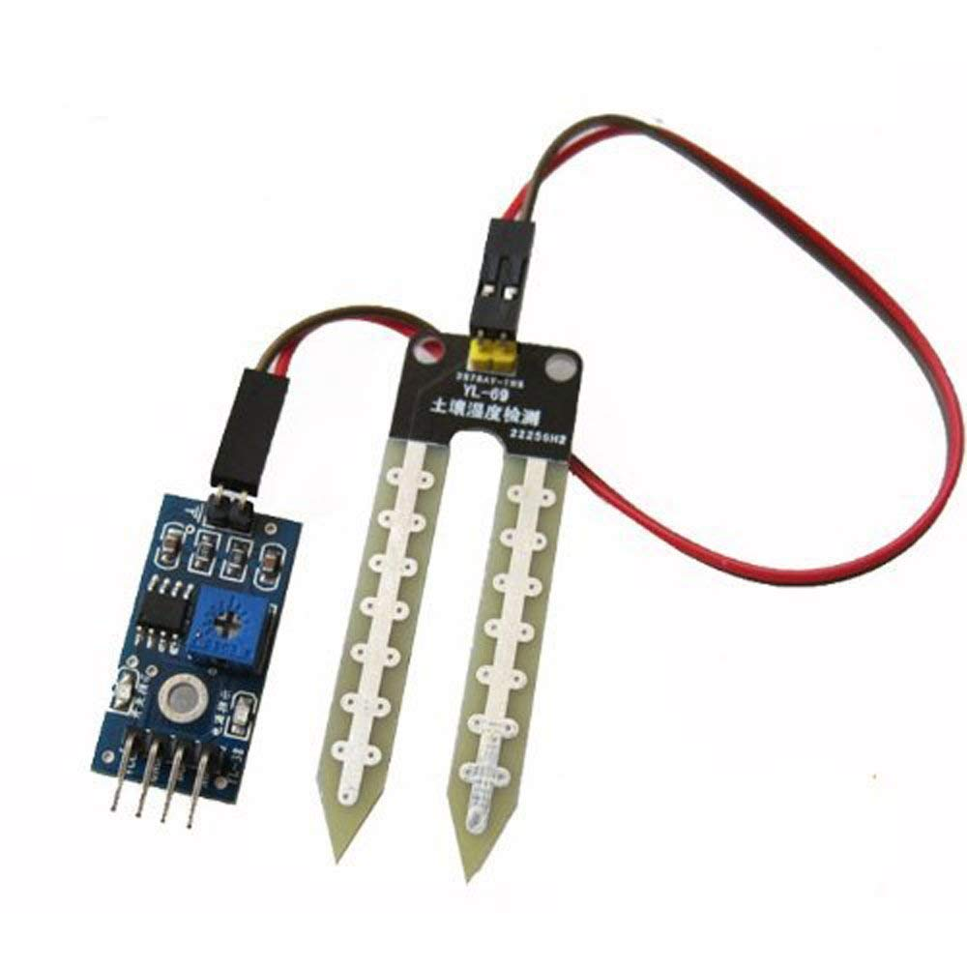
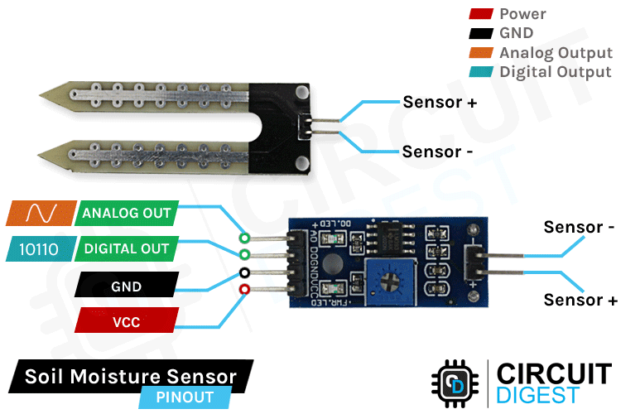
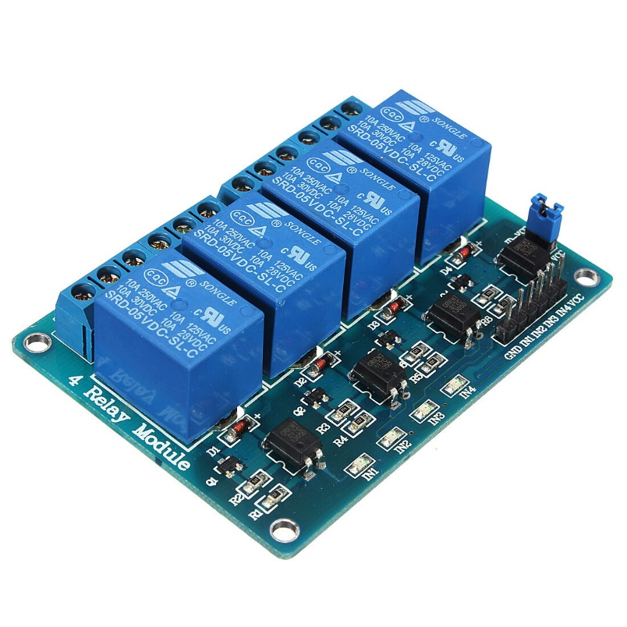
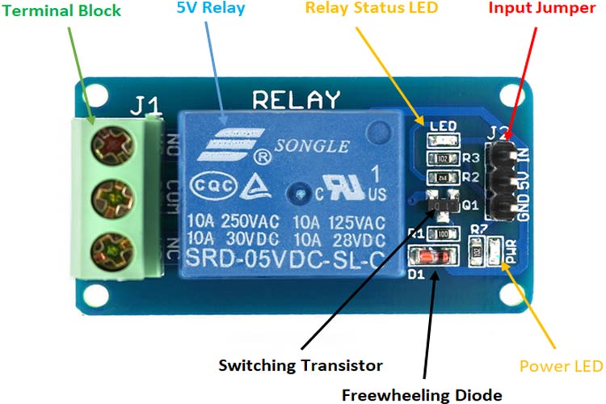

Slide 10
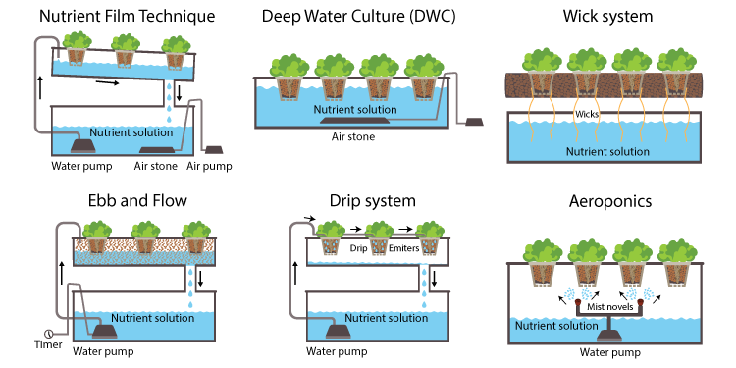
Types of hydroponic:-

Slide 11
Benefits:-
The technique of hydroponic farming has been used since ancient times. Hanging Gardens of Babylon is one such example. There are many benefits of growing plants hydroponically.
Plants grow faster so the yield is high.
Can be grown anywhere, underground, rooftops and greenhouses.
Plants can be grown where traditional farming is not possible.
Water and nutrients are recycled and reused.
Organic food can be produced without using fertilisers or pesticides.

Slide 12
Drawbacks:-
In spite of all the benefits, there are a few drawbacks of using hydroponics:-
High upfront investment.
Requires technical knowledge.
It can be misused to grow banned products and drugs like products, like marijuana.

Slide 13
Hydroponic setup:-
A hydroponic setup or a hydroponic plant requires certain components. Let us dive into each of the components separately.
Reservoir: It is the container that holds the nutrient solution required for the growth of plants. It is usually a plastic or glass container. A metallic container should not be used as it can bring harmful chemicals.
Grow Tray: A grow tray is essential in a hydroponic setup to hold the plants. It may have valves for better gripping and sometimes also contains mediums such as coco coir, clay and pebbles.
Growing Medium: A growing medium is the medium on which the plant grows, because there is no soil in a hydroponic setup. It can be vermiculite, coconut fibre, perlite or gravel.
Nutrient Solution: Nutrient solution is nothing but minerals dissolved in water. A nutrient solution for a hydroponic plant is prepared by dissolving essential minerals in required dosage to feed the plants.

Slide 14
Conclusion
Hydroponic system has great advantages in the real life world too , where we could continuously monitor the requirements a particular plant need .This is a fantastic combination of Agriculture and Internet Of Things .Hydroponic system could be of great use in the future as the system will continuously keep tracking of a particular plant and the soils quality which could prove as a gamechanger in future of agriculture technology

